Slide 1
(Cross-)Browser Fingerprinting
 | Song Li Johns Hoplins University lisong1013@gmail.com
Notes:
Hello everyone. Today, I want to talk about our work about cross-browser fingerprinting via OS and Hardware Level Features
//this is a research work do not one by one

Slide 2
Roadmap
Cross-browser Fingerprinting
Dynamic Fingerprinting
Measurement
How to prevent
Notes:
First of all, let me talk about the outline of this presentation.
I’ll start my presentation with the basic background. Next, I will introduce the design of our approach including known features, new features and improvement of known features.
In the end, I’ll show you the evaluation and conclusion of our work.
//background
//design
know
new
impr
//gray!!!!!!!!!!!!
//page number and total pages

Slide 3
Cross-browser Fingerprinting
Cross-browser Fingerprinting
Dynamic Fingerprinting
Measurement
How to prevent

Slide 4
Roadmap of current part
Background
Design
Existing features
New features
Improvement of existing features
Evaluation
Conclusion
Notes:
First of all, let me talk about the outline of this presentation.
I’ll start my presentation with the basic background. Next, I will introduce the design of our approach including known features, new features and improvement of known features.
In the end, I’ll show you the evaluation and conclusion of our work.
//background
//design
know
new
impr
//gray!!!!!!!!!!!!
//page number and total pages

Slide 5
Background
Background
Design
Existing features
New features
Improvement of existing features
Evaluation
Conclusion
Notes:
Well, let’s start with the background part
//background
//design
know
new
impr
//gray!!!!!!!!!!!!
//page number and total pages

Slide 6
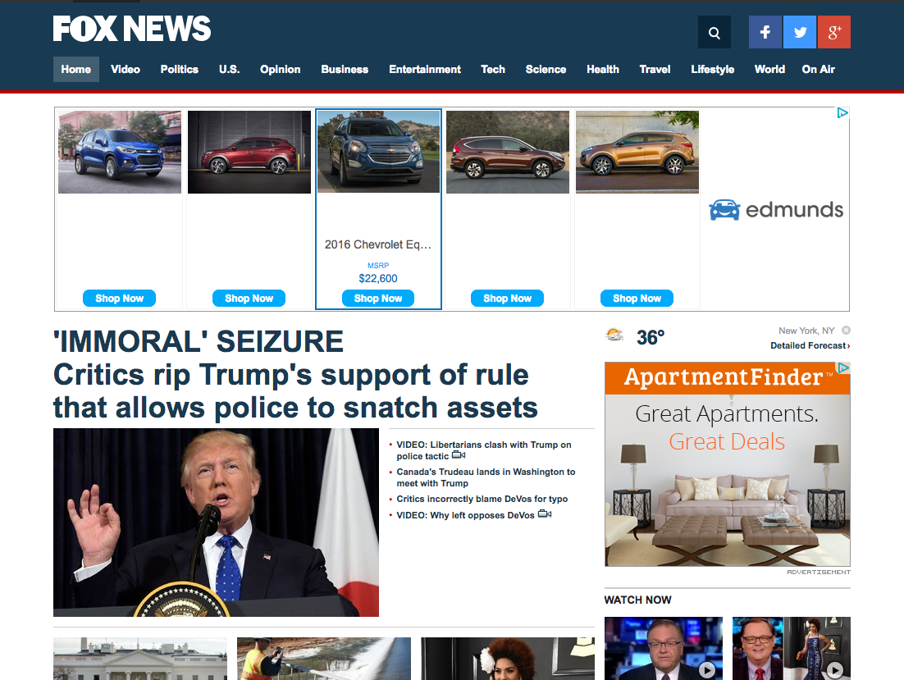
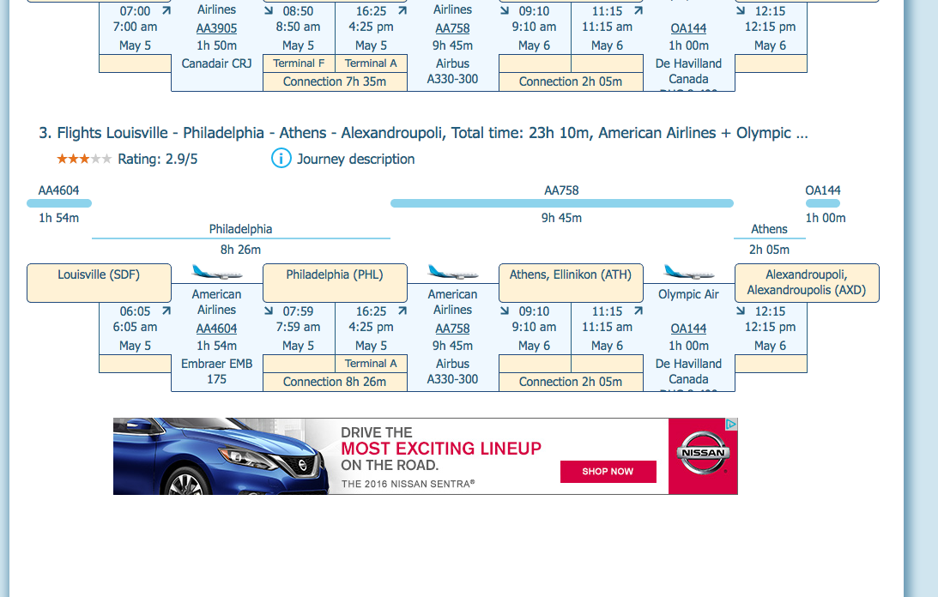
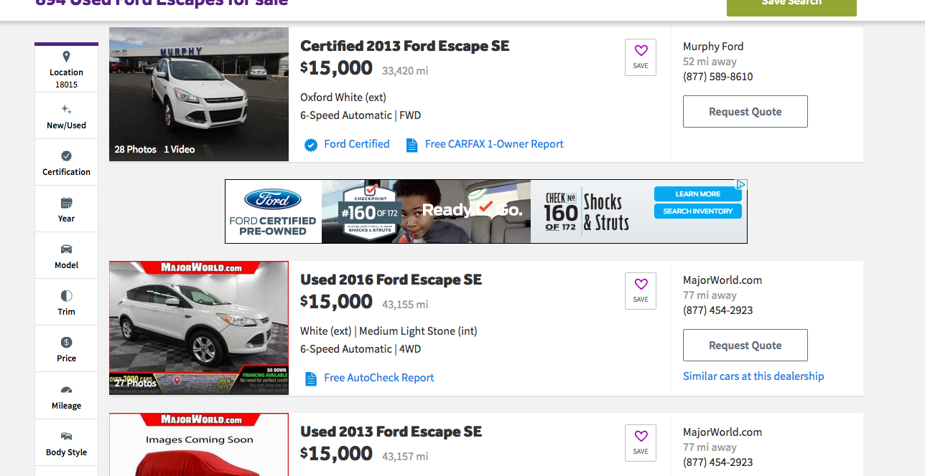
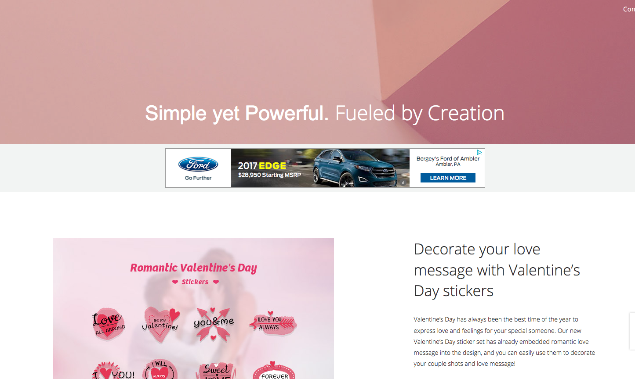
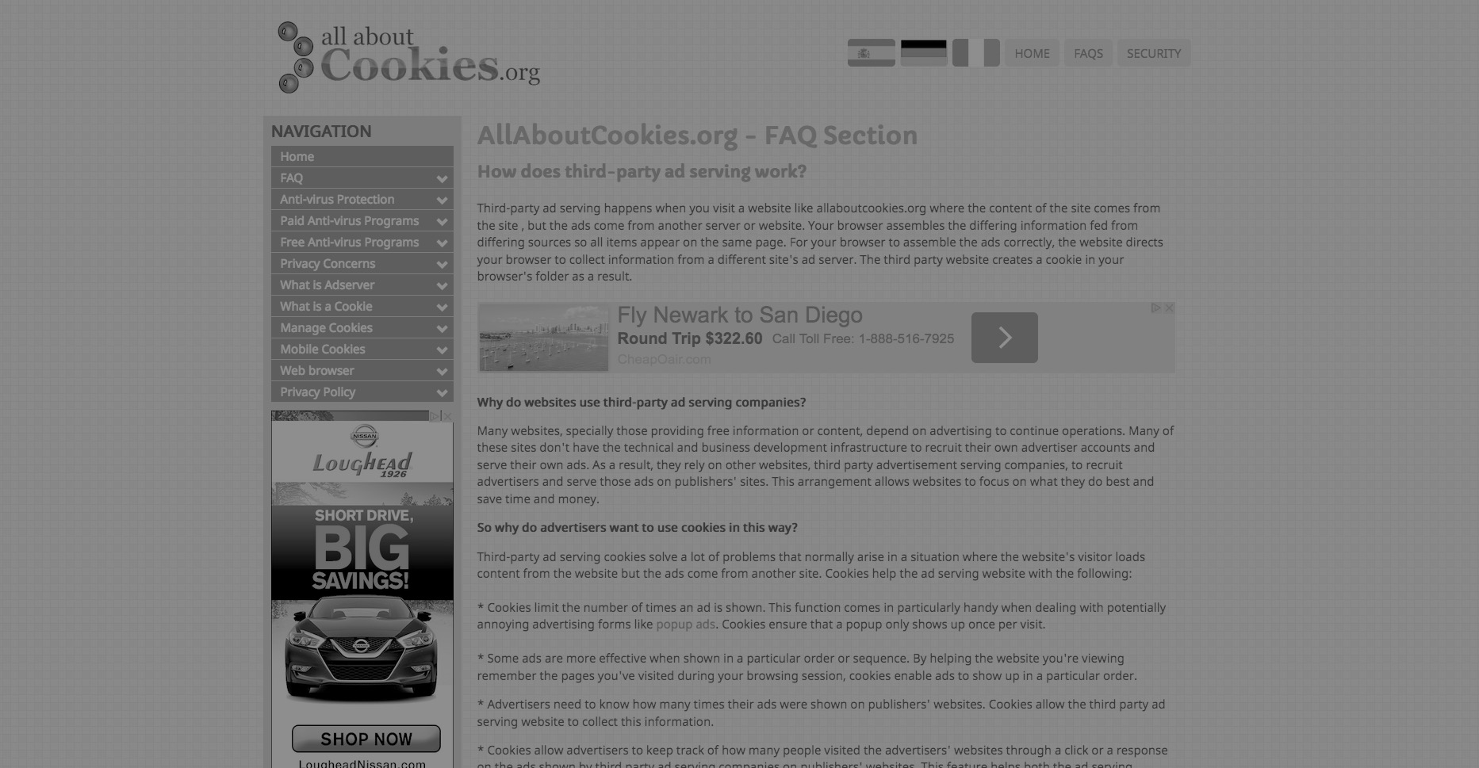

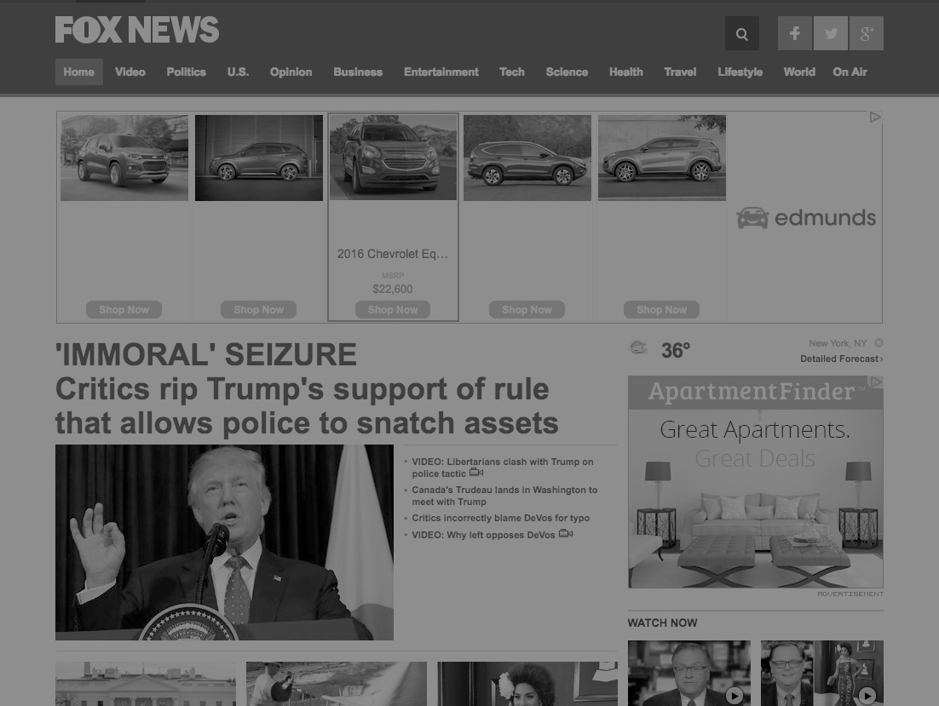
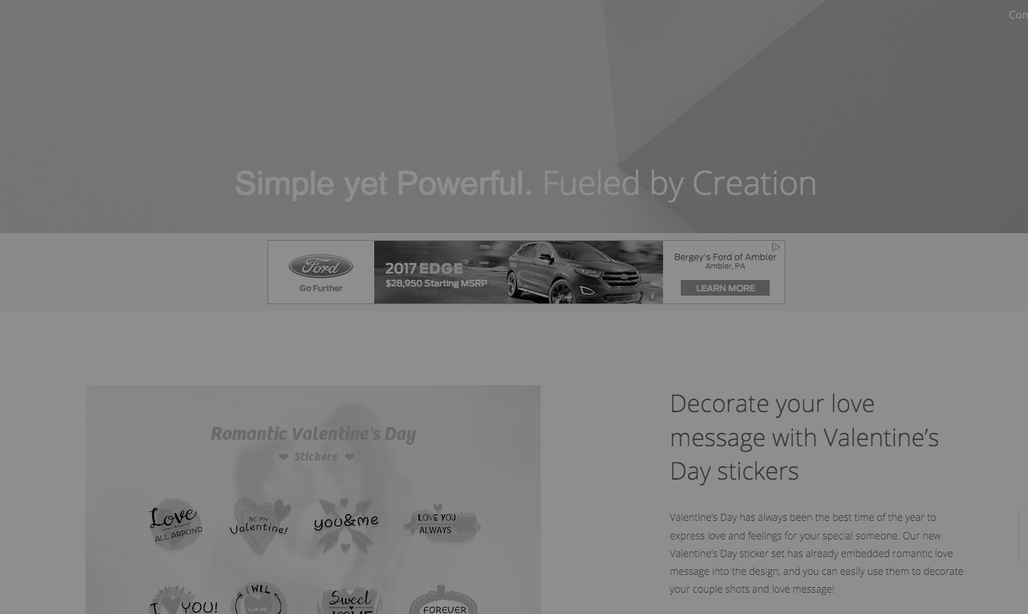
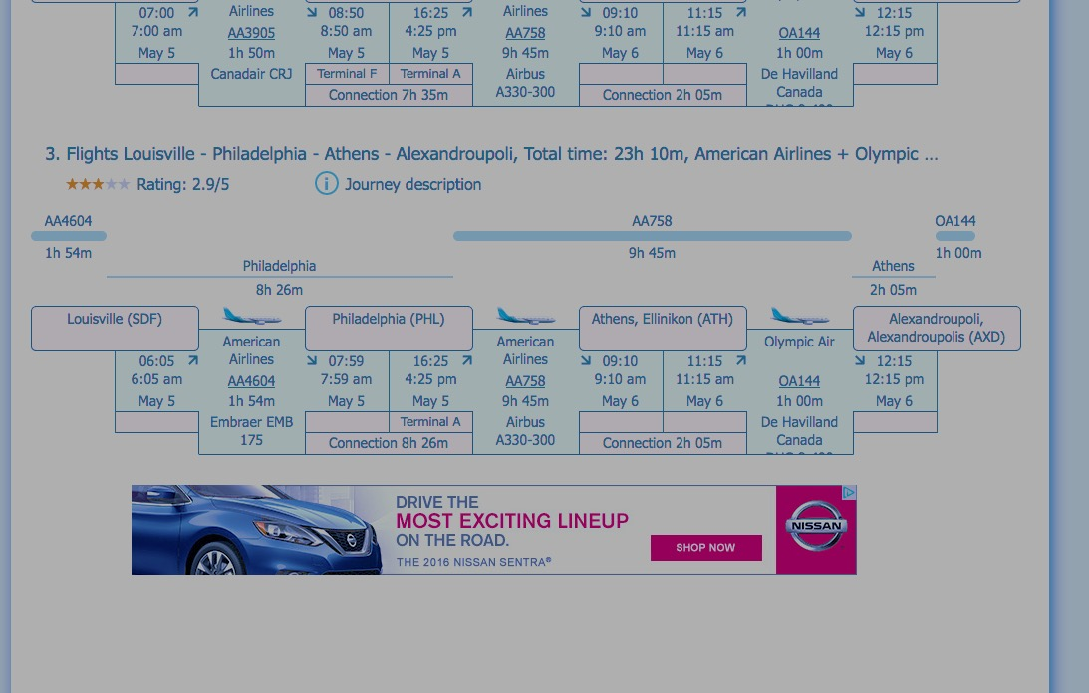
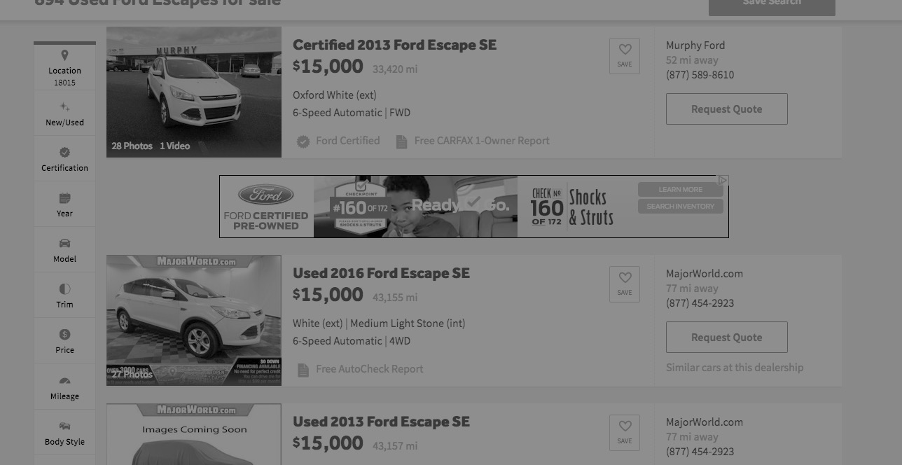

User Tracking
Notes:
Let’s imagine a situation.
1, Assuming that we want to buy a car, and we spent several hour in searching cars.
2, we felt a little tired and tried to relax our selives. We decorated some pictures, read some blogs and news, and then, we booked a ticket to San Diego.
3, we found a thing that in every page we viewed, the ads were pictures about cars. like this one, the fox news, the blog, the decoration website, and even the cars website.
4, recently we visited some webpages, from one to another. Each webpage has an ads and all of the ads belong to the same ads company.
5, If the ads company can get the fingerprint of users, this company would get the visiting chain and track users.

Slide 7
Identifier
Stateful
Stateless
Definition: Identify users by previously stored information
Cookie
Supper cookie
Definition: Identify users by features without stored information
AmIUnique^{[1]}, Panoticlick^{[2]}
User agent string
List of plugins
Notes:
For the identifier, there are two main kinds of identifiers: stateful identifier and stateless identifier.
1, Stateful identifier means keeping track of the information stored previously which is used for current transaction.
2, For example, a webpage can store some information to the cookie or supper cookie.
3, These kind of identifiers are pre-stored and can provide them a very accurate way to get the information of users.
4, The problem is those identifiers are easy to be cleared and modified.
1, Stateless identifier (known as fingerprinting) means every transaction is performed as if it were being done for the first time, so no previously stored information is used for the current transaction.
2, In this situation, web servers can get the identifiers of users by some features of browsers or operating systems. Like the list of installed plugins,
3, these kind of identifiers can get the identification of users in background without the actions of users.
4, Compared with the stateful identifier, stateless identifier is difficult to be modified so it’s more stable and safe. But stateless identifier is not accurate as stateful identifier.
1, Currently, we already have many related works like AmiUnique and Panoticlick. They use a list of OS and browser based features, like the user agent string and list of plugins to fingerprint users.
2, Since the features they uses are related to browsers, so they can only get the single browser fingerprinting which can only be used to fingerprint browsers.
//currently have two works. Briefly talk about them and useful features
//stateless means fingerprinting

Slide 8
Cross-browser fingerprinting
Survey Result: 70% of the surveyed users use two or more browsers regularly
Problem: Single-browser fingerprinting can’t identify user when changing browser
Key Insight: Adopting hardware and OS level features
i.e., cross-browser invariant
Notes:
//change the name
//talking about where is our survey from
There is one problem with the single-browser fingerprinting. Single-browser fingerprinting is highly rely on the browsers.
Based on our survey from Amazon Machnicalturk, around 70% of the surveyed users use two or more browsers regularly. If a user change it’s browser, we can’t identify this user any more. So we need to do a cross-browser fingerprinting. Cross-browser fingerprinting means we extract some computer-based features by JavaScript, those features do not depend on a single browser. no matter what browser used by the user, we can get the information of users based on these features.

Slide 9
Design
Background
Design
Existing features
New features
Improvement of existing features
Evaluation
Conclusion
Notes:
Now let’s continue with the design of our approach

Slide 10
A list of our features
Feature | Single-browser | Cross-browser
WebGL based GPU rendering result | Yes | Yes (Need Modification)
Supported language | Yes | Yes (Need Modification)
Number of CPU virtual cores | Yes | Yes
Screen ratio | Yes | Yes
List of fonts (JS based) | Yes | Yes (Need Modification)
Audio context | Yes | Yes (Need Modification)
Notes:
Here is a list of our features. They are ….. These features are based on both browsers and computers. Some of the features like cpu.. Can be directly used but for features like.., we need to extract the computer-based information and get ride of the influence of browser. It’s very interesting that the AmIUnique group thinks WebGL based GPU rendering is not suitable to be used as a feature, but based on our reasearch, WebGL can be used. Then I will talk about those features one by one.
//not the first to use webGL, amiunique can not be used as fingerprinting
//our approach show it can be used
//we can change the cite of paper

Slide 11
New features
Feature | Single-browser | Cross-browser
WebGL based GPU rendering | Yes | Yes (Need Modification)
Supported language | Yes | Yes (Need Modification)
Number of CPU virtual cores | Yes | Yes
Screen ratio | Yes | Yes
List of fonts (JS based) | Yes | Yes (Need Modification)
Audio context | Yes | Yes (Need Modification)
Notes:
Firstly, some new features were added to our research. They are …
//change to table

Slide 12
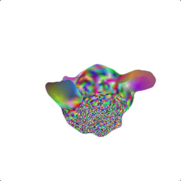

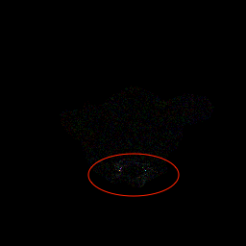
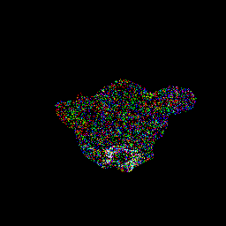
WebGL rendering
Most of WebGL animations are rendered by GPU
Different GPUs render pictures in different ways
Subtraction of result 1 and result 2
Subtraction of result 1 and result 2 (x200)
Result of GPU 1
Result of GPU 2
Notes:
//Change the background
//add label to every pictures
//use graphic card
Currently, most of the browsers support WebGL, and most of WebGL animations are rendered by GPU. Since different GPUs have different algorithms to render pictures, the result of rendered animations are slightly different. For example, if I want to render a picture with WebGL, this is the result of first GPU, this is the result of the second one. The results are same to each other, but if we subtract these two pictures, we can see there are some very tiny differences. If we make the subtracted picture brighter, we can see the results of two different GPUs are not same to each other. So in this way, we can extract some features from the rendered pictures and fingerprint GPU.

Slide 13

Example: texture mapping
? | ? | ?
? | ? | ?
? | ? | ?
 | ?
? | ? | ?
 | ?
Notes:
//talk abotu the algorithm used
So why different Graphic cards may have different rendering result? GPU needs to handle many tasks such as texture mapping and coloring. For example, in this picture. If we zoom out this picture, we can see this picture is made up of many piexls. If we want to map this picture to a bigger cube, like this, 4 pixels need to be mapped to 9 positions. So how to generate these 9 pixels? Four of them can directly use the pixels from the texture, for the other 5 pixels, different GPU may use different interpolation algorithms to do this. So the result of pixels can reflect some features of GPU.

Slide 14
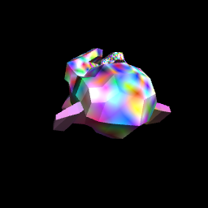
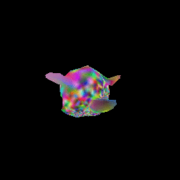
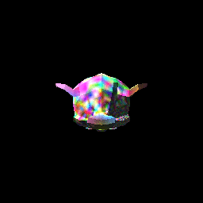
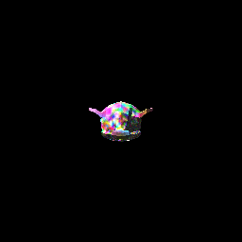
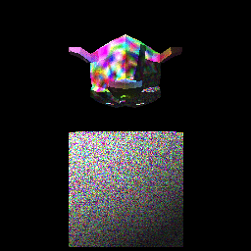
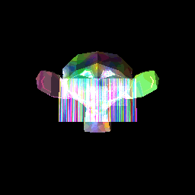
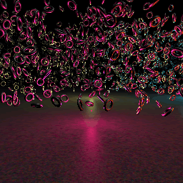
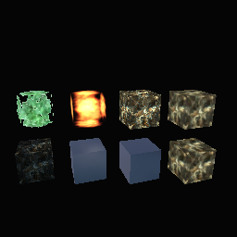
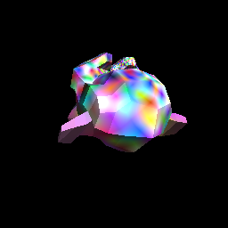
WebGL Rendering
Anti-aliased
Not anti-aliased
Texture
Light
Camera
Model
Transparency
Complex Lights
Anti-aliasing
Special textures
Notes:
//light with different colors
//add label to anti-aliasing pictures
In our approach, we put a randomly generated texture which can introduce more differences between different GPUs. Same as texture mapping, many other features may also reflect some aspects of GPU. Like Light, here we project some specific lights to the model. We can also change the position of camera, change a model or add a new model to the existing one to see how different model will influence each other. We also tried different level of transparency, tried to apply many lights together to see how different lights can influence each other.
Anti-aliasing is a technique to make lines in a picture smoother. For this picture, the picture in the right is not anti-aliased and picture in the left is anti-aliased which is smoother. Anti-aliasing is based on both browser and GPU.
//talk about the textures
We also tried many other special textures like PVR and DDS to see if a GPU support them or not. In this picture, the gray one is not supported and others are well supported
//what kind of special textures we are using
//not supported

Slide 15
Virtual CPU cores
Ways to get
New API (navigator.hardwareConcurrency)
Side channel detection (Run different number of JavaScript workers and measure the time)^{[3]}
Notes:
We also used the number of Virtual CPU cores to get the physical feature of CPU. Generally speaking, there are two ways to get the number of CPU cores. The first way is using new API (navigator.hardwareConcurrency) to get the number directly. This API is supported by the latest version of chrome and firefox. For other browsers which do not support this API, we can use side channel detection to get the number. The way to do this is to run different number of javascript workers and measure the time. For example, if we run our test in a 4 cores CPU. If we run less than 4 threads parallelly, the time should be same to each other. If we run more than 4 threads, the time should be different. In this way, we can get the number of virtual cpu cores

Slide 16
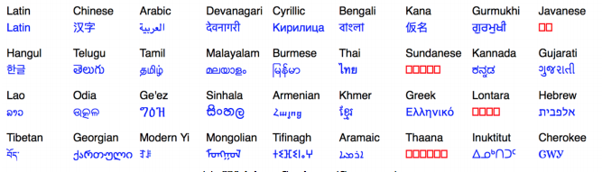
Writing scripts
Source: 36 popular different writing scripts (Wikipedia popular writing scripts)
Result: Shown as languages (supported) or boxes (unsupported)
Notes:
//prounce of Latin
Next new feature is the support of writing sciprts. Different computers may be different in the support of writing scripts. Most of the computer support english, some of them support chinese. We picked 36 most popular writing scripts from Wikipedia and tried to show them in browser. If a computer support this writing script, this writing script would be shown normally. Otherwise the writing script would be shown as boxes. For example, in this picture, the Latin and Chinese are supported but the Javaness is not supported. The support of writing scripts can also provide some information of the OS.
//Explain the boxes means
//How we select the languages
//Popular

Slide 17
Improvement of existing features
Feature | Single-browser | Cross-browser
WebGL based GPU rendering | Yes | Yes (Need Modification)
Supported language | Yes | Yes (Need Modification)
Number of CPU virtual cores | Yes | Yes
Screen ratio | Yes | Yes
List of fonts (JS based) | Yes | Yes (Need Modification)
Audio context | Yes | Yes (Need Modification)
Notes:
We also improved or purified some existing features to make them useful for cross-browser fingerprinting. Like audiocontext, the list of fonts and screen resolution
//how it been donw
//what is our imporvment

Slide 18
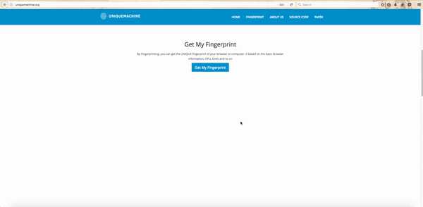
Screen resolution and depth
Existing Solution: screen.width, screen.height
Including AmIUnique etc.
Not stable for even single browser
Problem: affected by screen zoom levels
Method to solve this problem
Use the detected resolution times zoom level
Screen ratio
Notes:
Screen resolution should be a way to fingerprint a computer. But based on our collected data, we found that many users may zoom-in or zoom-out the webpage, which may lead to a wrong detection of screen resolution. So we improved our method to detect the zoom level of browsers and used the detected zoom level times the detected resolution to get the real resolution. This method also have problems with some browsers like safari. So finally, in order to build a better stability, we use the screen ratio instead of screen resolution. By the screen ratio and depth, we can also get some hardware level information.
//Color depth!
//why not stable
//zoom in and out
//our solution
//restore the real resolution

Slide 19
Audiocontext
Fingerprinting audio card
Our improvement: AudioContext
Method: Input some audio resources and capture the results^{[4]}
Problem: Influenced by both browsers and audio card
sampleRate (44100)
maxChannelCount (2)
numberOfInputs (1)
numberOfOutputs (0)
channelCount (2)
channelCountMode (explicit)
channelInterpretation (speaker)
Notes:
For audiocontext, other researchers already did some works. They input some audio resources and captured the result from browsers. The result is rendered by both audio card and browsers. By javascript, currently we can’t get the pure sound directly from the audio card. So the only thing we can do to fingerprint audio card is getting the basic features of audio card like the samplerates, ….. These are some hardware features can be directly captured and can also contribute to our research.
//citition
//what they did
//what we did
//wave into the audio
//cite their paper and what has been donw

Slide 20
List of fonts
Method: JavaScript based^{[5]}
Try to use different fonts
If not installed, back to default font
Measure the width of characters
Improvement: Select different subsets from 4,422 fonts (based on different OS)
E.g., Segoe WP and FreeMono
Default font
Abadi MT Condensed light
abcdefghijklmnopqrst
abcdefghijklmnopqrst
Width 2 inches
Width 1.5 inches
Notes:
//rewrite it
//talk about our improvement of our
//subset
//change the weihgt
The list of fonts also been used by many other researches. For browsers, generally speaking we have 2 ways to get the font list: flash and javascript. We know that flash is losing it’s popularity, so we picked the javascript way. The font list is mainly made of operating system fonts and web fonts. The OS fonts can be used to provide some os level information. So we select 4422 different fonts. Based on different operating systems, we use different subset of fonts, try to capture fonts from OS. For a specific subset, we use JS to check whether the font is supported or not. The way to do this is drawing a string to the browser with the font and measuring the width and height of the string. If the font is supported, the width would be slightly different from the default font. Otherwise, the font will go back to the default one and the length should be same as the default font.
//how exsisting people does
//other people
//masks??? Introduce what the mask is used
//select the subset not the mask

Slide 21
Evaluation
Background
Design
Existing features
New features
Improvement of existing features
Evaluation
Conclusion
Notes:
Now let’s talk about the evaluation of our research

Slide 22
Evaluation
3,615 fingerprints
Amazon Mechanical Turk
Microworkers
All over the world
Notes:
In this research, we collected data from more than 6000 computers from all over the world by amazon Mechanical Turk and microworkers.
//use number from paper
//put mechanical turk and micro to the ppt

Slide 23
Normalized entropies
 | Ours | AmIUnique | Panoticlick
User Agent | 0.612 | 0.570 | 0.531
List of Plugins | 0.526 | 0.578 | 0.817
List of Fonts(Flash) | 0.219 | 0.446 | 0.738
Screen Resolution | 0.285 | 0.277 | 0.256
Timezone | 0.340 | 0.201 | 0.161
Cookie Enabled | 0.001 | 0.042 | 0.019
Notes:
//the grounp need cookie enabled
This is a comparasion between our approach, amiunique and panopticlick. We can see the entropies of our data is comparable with them, which means our data is reasonable and can be used to measure our features.

Slide 24
Overall results
 | Single-browser |  | Cross-browser
 | Uniqueness | Entropy | Uniqueness | Entropy | Stability
AmIUnique | 90.84% | 10.82
Known features |  |  | 68.98% | 6.88 | 84.64%
Ours | 99.24% | 10.95 | 83.24% | 7.10 | 91.44%
Uniqueness: The percentage of fingerprints which are unique in all fingerprints
Stability: The percentage of fingerprints which are same in different browsers
Notes:
Here is the overall results of our approach. We can see we improved the single-browser fingerprint rate from 90.84% to 99.24%. For cross-browser fingerprinting, we can only compare our result with the known features, and improved the result from 68% to 83%. This result shows our approach can improve the result significantly.
Boda et al.??
//known features?
Change boda to exsiting features

Slide 25
New features results
 | Single-browser | Cross-browser
 | Entropy | Entropy | Stability
Screen Ratio | 1.40 | 0.98 | 97.57%
List of Fonts (JavaScript) | 10.40 | 6.58 | 96.52%
Audio Context | 1.87 | 1.02 | 97.48%
CPU Virtual cores | 1.92 | 0.59 | 100.00%
Writing Scripts | 2.87 | 0.51 | 97.91%
GPU Texture test | 3.5 | 2.26 | 81.47%
GPU Light test | 3.52 | 2.27 | 81.23%
All cross-browser features | 10.92 | 7.10 | 91.44%
Notes:
//add GPU
For the results of new features. In order to get a better cross-browser result, the stability result of all the features 95%. In this situation, the features can still provide enough entropy and the combination of them can provide an entropy 7.1
//WebGL result

Slide 26
Cross-browser Fingerprinting Uniqueness and Stability
Browser | Chrome | Firefox | Edge | IE | Opera | Safari | Others
Chrome | 99.2% (100%)
Firefox | 89.1% (90.6%) | 98.6% (100%)
Edge | 87.5% (92.6%) | 97.9% (95.9%) | 100% (100%)
IE | 85.1% (93.1%) | 91.8% (90.7%) | 100% (95.7%) | 100% (100%)
Opera | 90.9% (90.0%) | 100% (89.7%) | 100% (100%) | 100% (60.0%) | 100% (100%)
Safari | 100% (89.7%) | 100% (84.8%) | N/A | N/A | 100% (100%) | 100% (100%)
Others | 100% (22.2%) | 100% (33.3%) | - | - | 100% (50%) | - | 100% (100%)
Uniqueness (Stability)
Notes:
//explain uniqueness and stability
This table is a comparison for different pair of browsers. In each grid, the number on the left means the uniqueness and the number in the parenresis means the stability. We can see, for most of the browser pairs, the uniqueness is more than 85% and the stability is more than 90%, some browsers never appear together like safari and Edge or IE, so we have to put N/A there.

Slide 27
Conclusion
Background
Design
Known features
New features
Improvement of known features
Evaluation
Conclusion

Slide 28
Conclusion
Single browser
Cross browser
Improved the uniqueness of existing work
90.84% (AmIUnique) -> 99.24% (ours)
A reliable and usable approach to fingerprint machine
83.24% uniqueness and 91.44% stability
Notes:
Now comes to the conclusion. We improved the uniqueness for single browser from 90.84% to 99.24%. For cross-browser fingerprinting, we created an usable way to fingerprint a computer instead of a browser by extracting some hardware level and OS features. the result of our approach is also great with 83.24% uniqueness and 91.44% stability.
//amiunique
//from 90% to 99% //exact number needed here
//cross-browser
//uniqueness and stability

Slide 29
Dynamic Fingerprinting
Cross-browser Fingerprinting
Dynamic Fingerprinting
Measurement
How to prevent

Slide 30
Roadmap of current part
Introduction
Major challenges

Slide 31
Introduction
Browser fingerprint may change by time
Browser update
OS update
Hardware changes
Software update
etc.
One browser instance may have multiple fingerprints

Slide 32
Major Challenge
Rule based
Hard to get the differences of images and hash values
Machine learning
Hard to generate the distance between feature values
Performance issue
For new fingerprints, we need to compare with all fingerprints

Slide 33
Measurement
Cross-browser Fingerprinting
Dynamic Fingerprinting
Measurement
How to prevent

Slide 34
Measurement
15,500,788 visiting records
960,853 pieces of dynamic information
From 661,827 browser instances
Measured dynamics of fingerprints
The percentage of different change reasons
The stability of different browsers, operating systems
The relation between different features
The uniqueness of different browsers

Slide 35
How to prevent
Cross-browser Fingerprinting
Dynamic Fingerprinting
Measurement
How to prevent

Slide 36
How to prevent
Against timing attack
Deterfox, a deterministic browser
Against GPU related attack
UniGL, a high-performance deterministic rendering engine written in JS

Slide 37
Thank you
Any questions?

